Slide 1
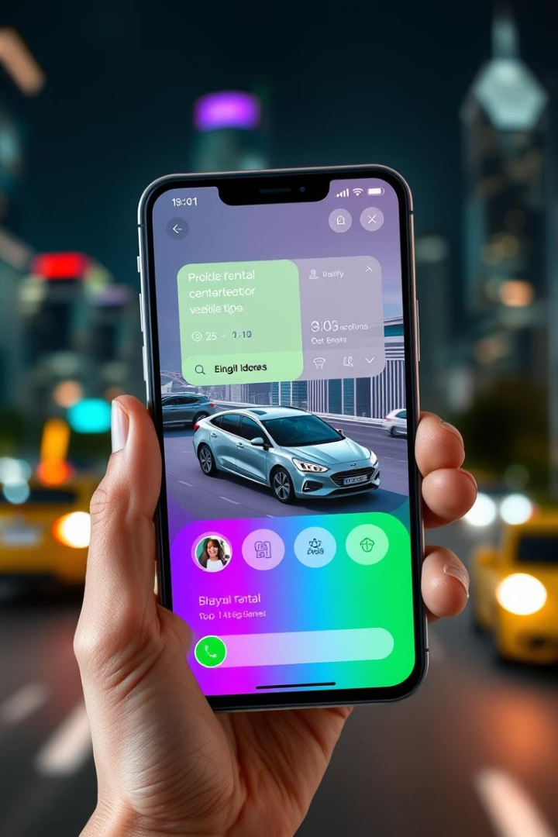
CS253 PROJECT - FLEET BY TEAM NULL POINTERS

Slide 2
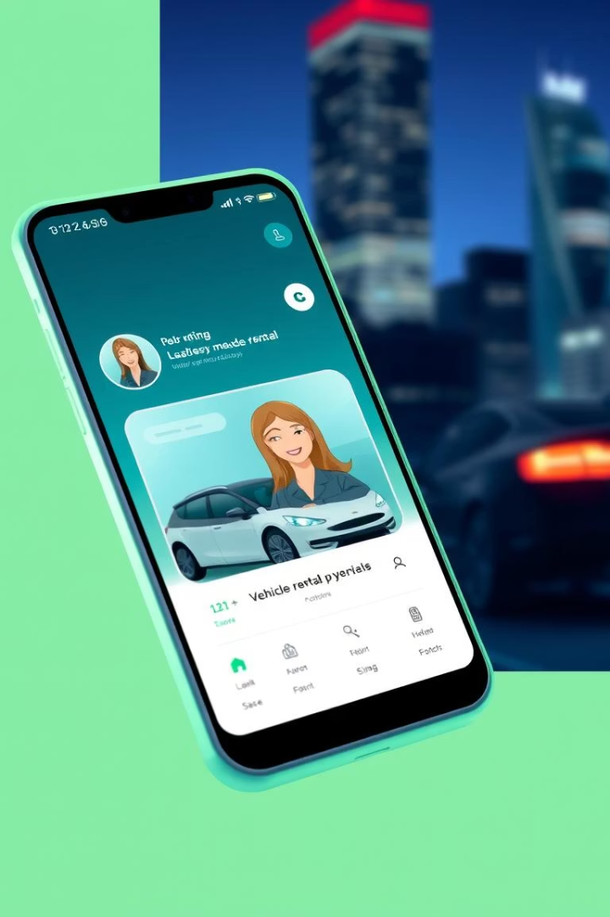
Fleet: Revolutionizing Vehicle Rentals
Fleet is a comprehensive web-based platform designed to simplify and streamline the process of renting vehicles. We connect owners, renters, and drivers. Our platform offers seamless booking and enhance customer experience.

Slide 3


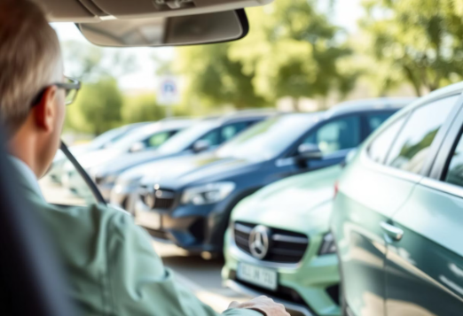
Potential Users
Companies
Organizations
Individuals
Digitize operations and scale your vehicle rental business.
Streamline vehicle access for tourism and corporate needs.
Access vehicles for short trips, vacations, or moving items.

Slide 4
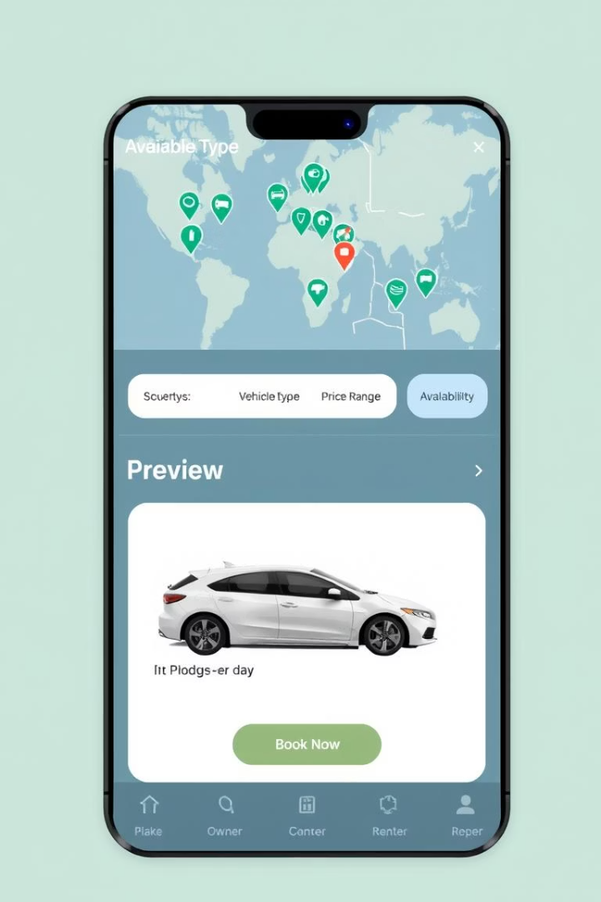
Key Functional Requirements
User Interface
Vehicle Listing
Easy navigation. Search by type, price, and availability.
Details, photos
Bookings
Admin and User Portals
Real-time bookings
Easy-to-use portals for admin to manage vehicle listings and for users to manage rentals.

Slide 5





Key Non-Functional Requirements
Performance
Security
Quick booking confirmation.
Secure user authentication.
Verification
Responsive
Email verification.
Mobile and desktop responsive.

Slide 6
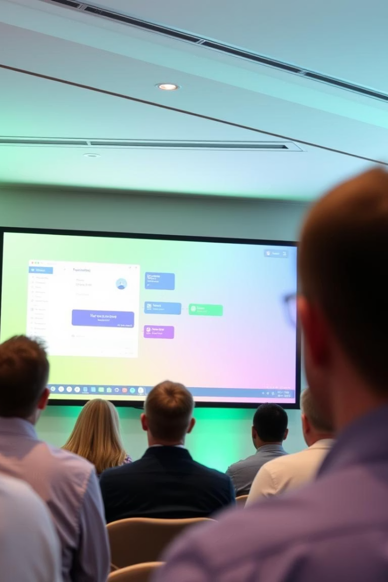
Demonstration
Let's dive into a live demonstration. See Fleet in action and experience its features firsthand. Watch how Fleet streamlines vehicle rentals. Understand how Fleet enhances user experience.

Slide 7

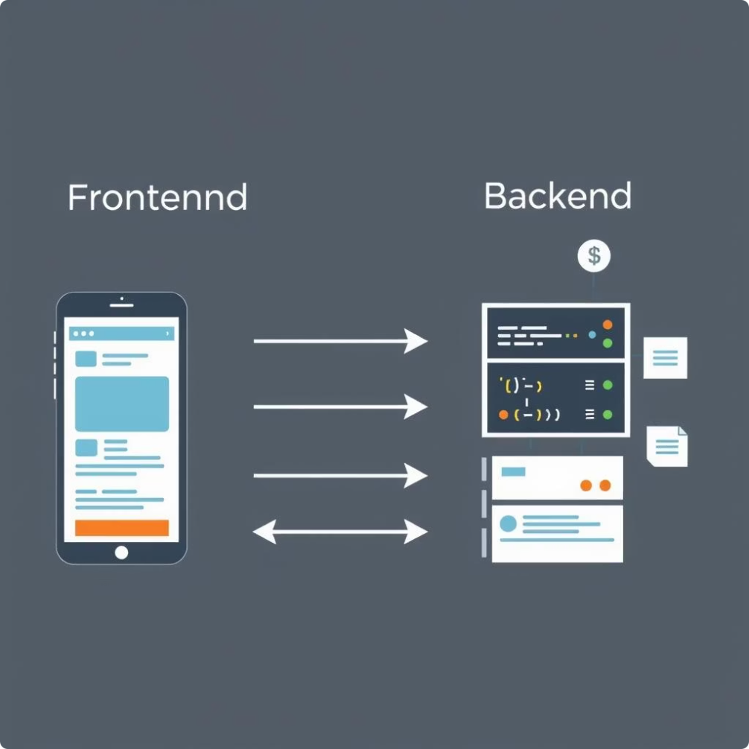
Implementation
Frontend
HTML, CSS and JavaScript were used in the frontend. We used React.js as a template framework.
Backend
The backend was written in JavaScript and we used Express since it makes building web apps simpler. MongoDB was used to handle the database, as it is user-friendly and easy to use.

Slide 8
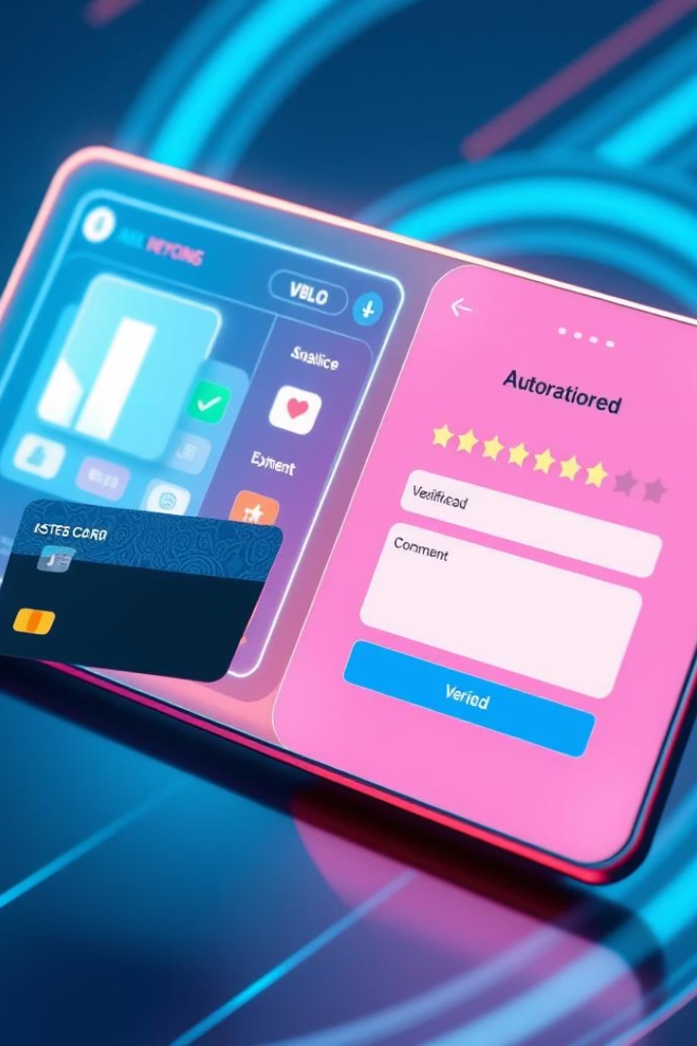
Future Improvements
1
Seamless Payments
Integrate a UPI payment gateway for easy, secure bookings.
2
Enhanced Feedback
Add a comment section for detailed user reviews.
3
Driver Interface
Develop a dedicated driver interface to track availability and driving history.
4
Automated Verification
Integrate Digilocker for real-time driving license validation.

Slide 9




Lessons Learnt
Web Applications
Gained hands-on experience with real world web applications.
Team Work
Learned the importance of collaborative problem solving with the team.
Plan Driven
The whole project was plan-driven, meeting various deadlines on time taught us the value of time-management and planning.

Slide 10

THANK YOU

